Slide 1

Centraal Bureau voor de Statistiek
Identification of Cybercrime Victims
Presentation about our project 29-11-2019
Susan van Dijk – CBS Contact person
Abdoul Etaoil
Rik Verhulst
Job Bakker
Nicky Aardse
David Stenvatten
Notes:
Rik

Slide 2
Research Goal
Centraal Bureau voor de Statistiek
Our research goal:
Which economic, demographic and psychological features associate positively with (a type of) cybercrime victimization of Dutch citizens in 2016?
Notes:
Rik

Slide 3

Specification
Centraal Bureau voor de Statistiek
Types of crime
Traditional crime
Theft
Traditional Crime with IT means
Bankcard fraud
Crime with IT as as goal
DDoS
Cybercrime predictor definition of cybercrime

Slide 4
Dataset
Centraal Bureau voor de Statistiek
Our data and how we use it
Police data 2016 (982227 rows x 24 columns)
ID | Cybercrime (V) Traditional crime (X) | Features
### | X | value
### | V | value
Known victims and reporters of cybercrime
Known victims and reporters of regular crime
SSB 2016 (22022304 rows x 26 columns)
ID | Features
### | value
### | value
Social economic facts about individuals
Demographic facts about individuals
Safety Monitor data 2016 (80860 rows x 1893 columns)
ID | Cybercrime | Features
### | X | value
### | V | value
A survey which shows how safe people feel in different areas (e.g. on the internet) and if they had been victimized by (cyber)crime
Notes:
Rik

Slide 5
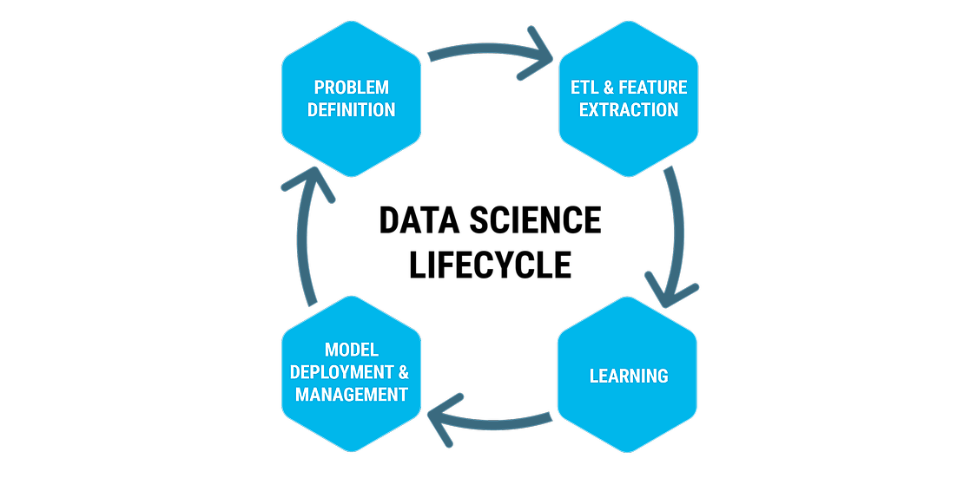
Centraal Bureau voor de Statistiek
Exploratory data analysis

Slide 6
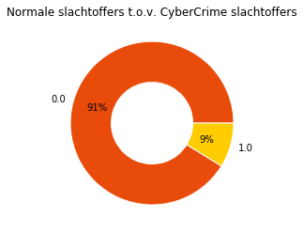
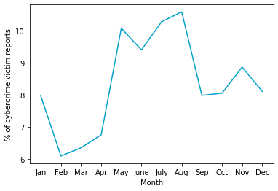
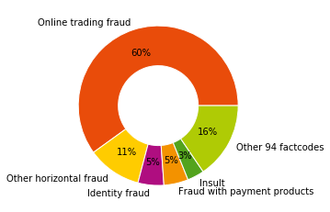
Plots
Centraal Bureau voor de Statistiek
Plots
Notes:
Type crimes toevoegen cybercrime

Slide 7
Method
Centraal bureau voor de Statistiek
Dimensionality reduction
Feature extraction and Feature elimination

Slide 8
So far
Centraal Bureau voor de Statistiek
Machine Learning:
Why?
What?
How?
No results with regular methods
ML can detect more advanced patterns
Perceptron
Logistic Regression
Random Forest
KNN
t-SNE
PCA
Support Vector Machine
Autoencoder
Try to make a well performing model for the dataset and look at what features seem useful to make predictions/classifications.
Notes:
Nicky

Slide 9
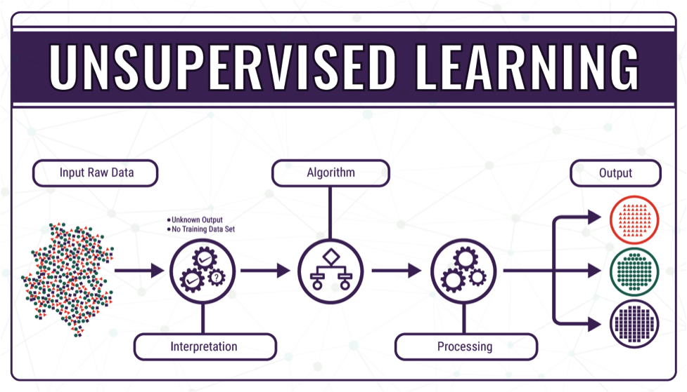
Centraal Bureau voor de Statistiek
Unsupervised ML

Slide 10
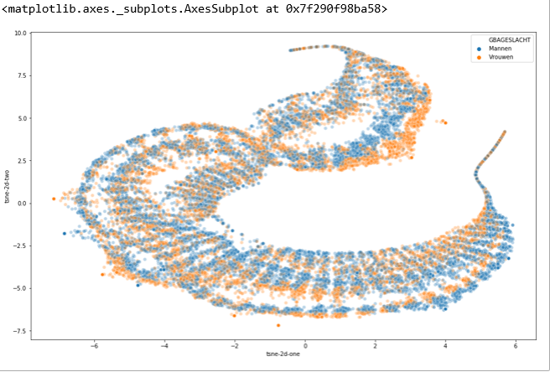
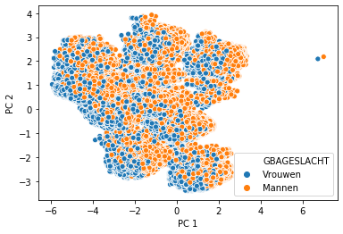
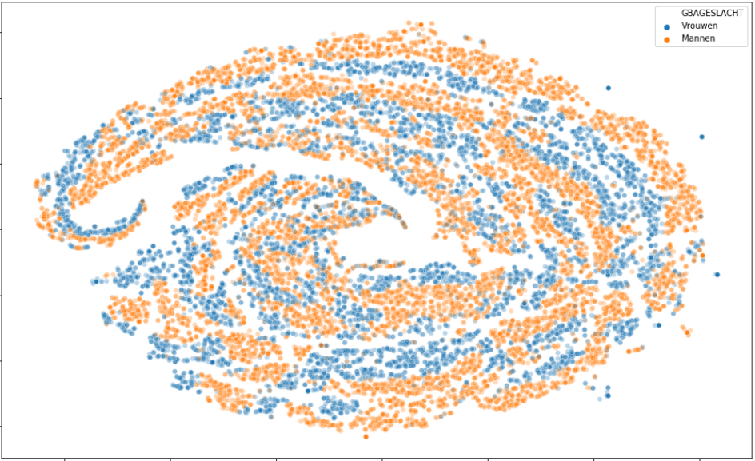
Centraal Bureau voor de Statistiek
t-SNE
Principal component analysis

Slide 11
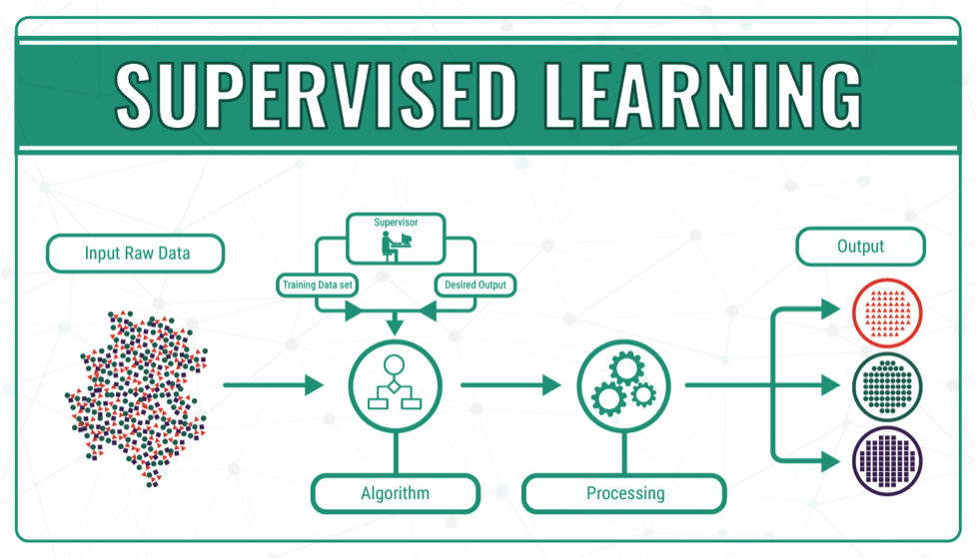
Centraal Bureau voor de Statistiek
Supervised ML

Slide 12
Sample datasets for ML
Centraal bureau voor de Statistiek
Then we also took non-victims
Cybercrime victims (61000 rows)
ID | SSB characteristics | Traditional crime | Cybercrime
### | … | 0 | 1
### | … | 0 | 1
61000 random persons who are defined as cybercrime victim (both classifier_predictions and AGSOslo positive) within the police data
Traditional crime victims (61000 rows)
ID | SSB characteristics | Traditional crime | Cybercrime
### | … | 1 | 0
### | … | 1 | 0
61000 random persons who are defined as non-cybercrime victim (classifier_predictions negative and AGSOslo positive) within the police data
Non-victims (61000 rows)
ID | SSB characteristics | Traditional crime | Cybercrime
### | … | 0 | 0
### | … | 0 | 0
61000 random persons who are not defined as any crime victim (AD_TOTGENERAAL_DELICTc negative) within the safety monitor
Notes:
Nicky

Slide 13
Centraal Bureau voor de Statistiek
2 highest accuracy models
 | Logistic Regression | Gradient Boosting
Accuracy | 0,66 | 0,66
Top 5 features | Older than 65 years Till 18 years old Married couple w/o children 25 to 45 years old 18 to 25 years old | Older than 65 years Married couple w/o children 45 to 65 years old Female Male
Notes:
Nicky

Slide 14
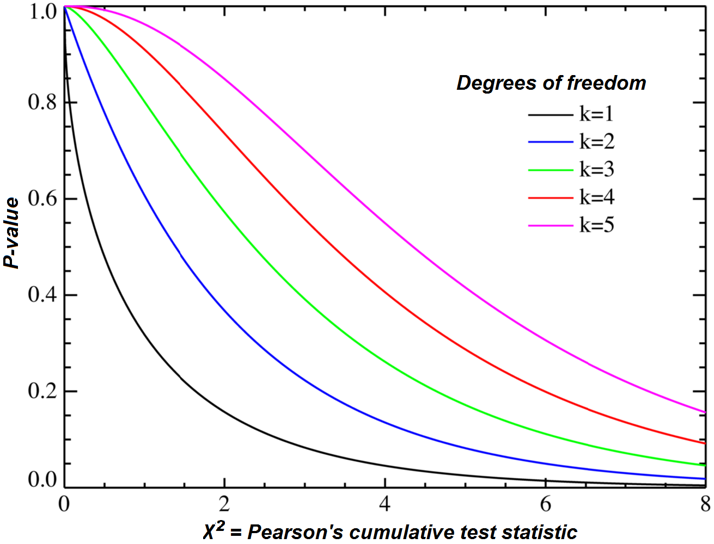
Centraal Bureau voor de Statistiek
Chi-squared test
Notes:
Nicky

Slide 15
Chi-squared
Centraal Bureau voor de Statistiek
Why Chi-sqaured?
Used for feature selection
It shows (in)depenence between 2 (or more) variables.
Feature
 | 0 | 1
0
1
Cybercrime victim
Population 1 size
+
Population 2 size
Feature amount
Feature amount
=
+
=
Total amount

Slide 16
Chi-squared
Centraal Bureau voor de Statistiek
Example:
Observed
Expected
 | 0 | 1
0 | 80 | 20
1 | 40 | 75
 | 0 | 1
0 | 56 | 44
1 | 64 | 51
O = Observed
E = Expected
X² = Chi-square score
100
100
115
115
120
95
225
120
95
215
X² = 0,090
p-value = 0,05 (significance treshold)
Critical value = 3,84
(depend on degree of
freedom and p-value)
H0 > Variables are independent
H1 > Variables are dependent
0,090 < 3,84 => Fail to reject H0
No significance.

Slide 17
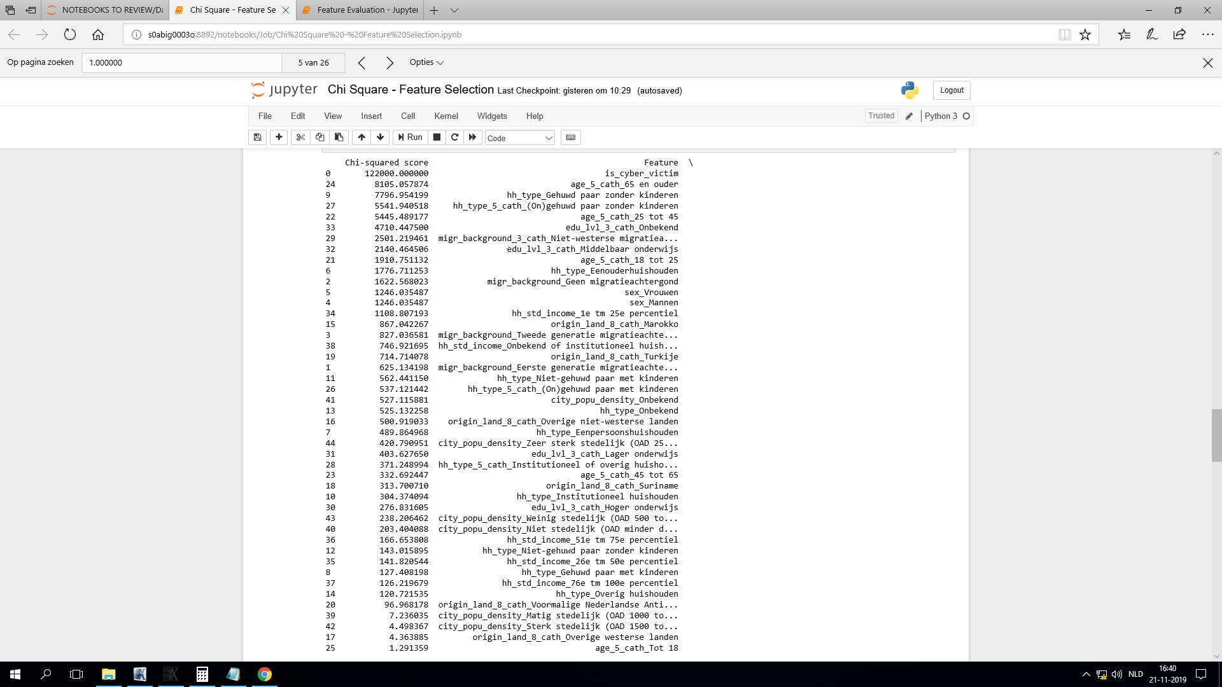
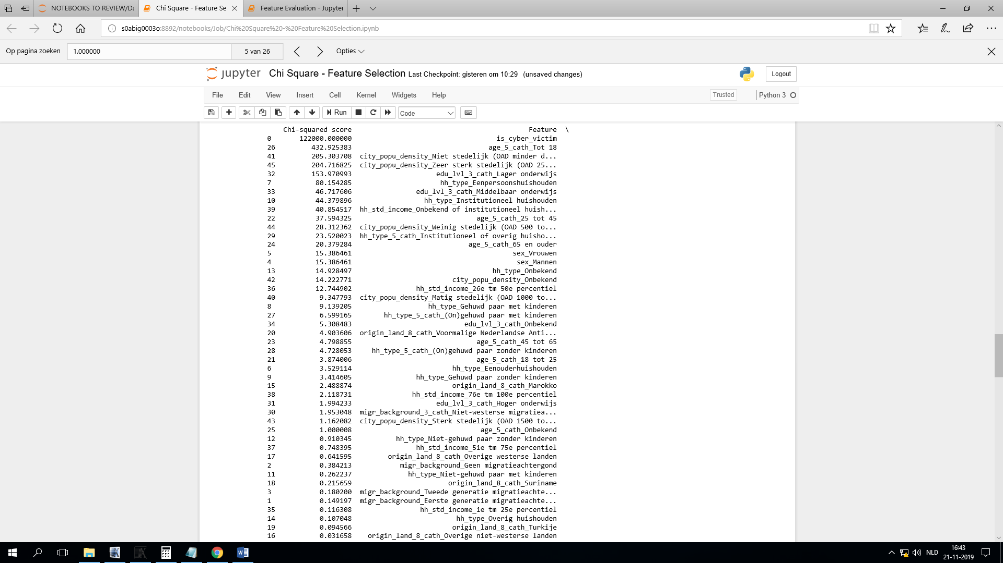
Chi-squared test
Centraal Bureau voor de Statistiek
Chi-squared test results
Cybercrime victims vs non-victims
Cybercrime victims vs traditional crime victims
Notes:
Higher score = higher difference of that variable between the two groups

Slide 18
End
Centraal Bureau voor de Statistiek
Questions?
Notes:
Nicky

